Slide 1


University College Of Engineering & Technology (UCET) Vinoba Bhave University, Hazaribagh (825301)
PPT Presentation on
STUDENT INDUCTION PROGRAM
(22-12-2020 to 21-01-2021)
- Presented by
PRIYANSHU RAJ
ROLL No :- 2011122
BRANCH :- I.T.(1ST SEM)
SESSION :- 2020-2024

Slide 2
Contents
Serial No | Topics | Covered by
01 | Computer Literacy | Archana Reena Dhan
02 | Universal Human Value | Suvir kumar
03 | Lecture On Entrepreneurship | Anubhav tiwari
04 | Financial Literacy | Swayam Prabha
05 | LBEP | D.K Singh
06 | Examination and Evaluation | Vijay Kr. Besra
07 | SELP (Arts Of Living) | Vibhu Gautam
08 | Alumni Interaction | Randhir Kumar
09 | About Startup Cell | Chandra Bhushan Kumar
10 | Bridge Course (Math) | Pankaj kr. Manjhi
11 | Bridge Course ( Physics) | Navin Chandra

Slide 3
Contents
Days | Topics | Covered by
12 | Bridge Course (Chemistry) | S . K. Sahay
13 | Interaction With TEQIP Coordinator | Arun Kr. Mishra
14 | Interaction With NSS Coordinator | Johny Ruphina Tirkey
15 | Hands On Python | Nilabh Kumar
16 | Workshop On Animation | Amit Kumar

Slide 4

1. Computer Literacy
What is Computer ?
An electronic device that takes input from the user and process these data under the program and gives the result as output.
History of computer ?
The computer as we know it today had its beginning with a 19th century English mathematics professor name Charles Babbage.
Major components of computer?
CPU
Input device
Output device
Memory Unit
Buses
I/O Port

Slide 5

2. Universal Human Value
Introduction of Universal Human Value?
Universal human value is mainly about issues related to our happiness , our welfare , our aspiration , goals and succes in life.
What are the common human values?
Dependability
Reliability
Loyalty
Commitment
Open-mindedness
Honesty
Efficiency
Which is the most important value of human?
Wisdom
Integrity
Trust
Respect

Slide 6

3. Lecture On Entrepreneurship
Difference between start-ups and traditional companies?
Traditional tools will not work in startups because big companies or corporation and startup use different approaches and have different skills.
What service(s) or product(s) do you offer/manufacture?
Software Development (Application Development)
Software System Integration
Graphic Design (Web & Print Design &Development)
IT Consulting
How do you advertise your product/service?
Twitter
Face book
Blogging
web site
Events & Seminars
Cold calling
Warm calling
Partnership

Slide 7
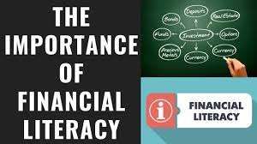
4. Financial Literacy
What is financial literacy ?
It is the ability to understand how to make sound financial choices so you can confidently manage and grow your money.
Why is financial literacy important ?
Financial literacy consumers can manage money with confidence which means effectively
allocating their earnings to their goal.
Understand how to budget
Understand and manage debt
Understand how an emergency fund
Plan for retirement
What about financial planning ?
Top golden rules for financial planning:-
Manage your money
Regular your expenses wisely
Maintain a personal balance
Planning for retirement
Planning your taxes

Slide 8
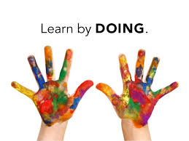
5. Lecture by Eminent Person(LBEP)
Life skills developments :-
Purpose Of Education :-
3-H (Head , Hand , Heart)
4-H(Head , Hand , Heart , Health)
Most important life skills for students :-
Focus and self – control
Perspective – taking
Communication
Critical thinking
Taking on challenges
Components Of The Experiential Learning Model :-
“ Learn By Doing”
We remember :
10% of what we read.
20% of what we hear.
30% of what we see.
50% of what we see and hear.
70% of what we see , hear and discuss.
90% of what we see , hear , discuss and practice.

Slide 9

5. LBEP (Continue…)
About placement :-
On Campus
Off Campus
Communication Skills
Writing Skills
Maintain cgpa
About Moral Education :-
Citizenship
Caring
Fairness
Responsibility
Respect
Trust

Slide 10
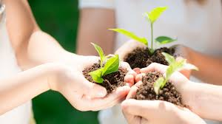
5. LBEP (Continue…)
Environmental Science
Environment :-
All the external factors living and nonliving , material and nonmaterial which surround man.
In general :-
It includes water , air , soil and the social – economical conditions which we are living .
Biotic factors :-
All the living things that directly or indirectly affect the environment.
Thus , the organism, their presence,parts,interaction and wastes are all biotic factors .
Why Biodiversity is important ?
Provides food , fodder , fruit , fuel timber , medicine .
Value of a Tree -
A tree that lives for 50 years generates :-
Rs. 5.3 Lac worth of oxygen .
Soil erosion control .
Creates Rs. 6.4 Lac worth of air pollution control .
Provides Rs. 5.3 Lac worth of shelter for birds and animals.

Slide 11
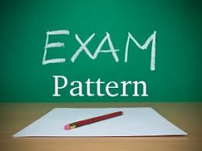
6. Examination And Evaluation
Full Marks – 100
Passing Marks – 35
University Examination – 70 Marks
Total questions – 8 (5 question to be solved) ; (5*14=70)
Internal Assessment – 30 Marks
Mid sem exam – 10 Marks
Teacher Assessment – 20 Marks

Slide 12

7. SELP(Arts Of Living)
The seven layers of existence are :-
Body
Breath
Mind
Intellect
Memory
Ego
Self
What are our desires ?
Quick
Smart
Stylish
Live in the present moment.
Opposite value are complementary to each other.
Live in your self.
Give 100% of your work.
Must accept as the person is.

Slide 13
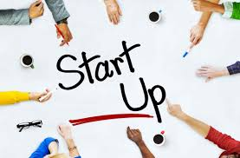
8. Alumni Interaction
What is startup and its type ?
A startup is a temporary organization designed to search for a repeatable and scalable
business model , while the small business runs according to the fixed business
model.
Six Type of Start-ups :
Lifestyle startups
Small business startups
Scalable startups
Buyable startups
Large company startups
Social startups

Slide 14
8. Alumni Interaction (Continue…)
Is startup a good idea ?
Working in startup means you are an important member of a small team . A startup has
less people so everybody’s role is imp. This leads to being more responsible , reliable ,
versatile and willing to explore so as to improve.
Are startups good or bad ?
Working for a startup can offer a lot of advantages . Some startups are willing to pay higher
salaries then well – established companies , while others offer fun perks and unique
cultures. But all the free lancers in the world don’t outweight the risks of startup life .

Slide 15

9. About Startup Cell
Introduction :-
Start India is a flagship initiative of the government of india , intended to build a strong eco – system for nurturing innovation and startup in the country that will growth and generate large scale employment opportunities .
Action Plan Of Government :-
From digital technology sector to a wide array of sectors including .
Agriculture , manufacturing , social sector , healthcare , education etc .
Funding support and Incentives
What is startup India scheme ?
The economy of every country depends on its countrymen . Larger the number of empoyed or
Working people , better the economy .
Narendra Modi in his speech that Indians have ideas & capability , all the need is a little push .
Investment :-
Pradhan Mantry Mudra Yojana is also one of the similar initiatives the refinance the micro units .

Slide 16
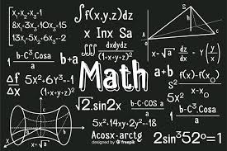
10. Bridge Course (Math)
Mathematics: The science or study of numbers, quantities or shapes.
Set :-
A set is a collection of objects or number .
Membership
Subset
Venn Diagram
Power Set
Cardinality
Basic Operation
Relation :-
Let A and B be two non – empty set . Then a relation R defined from A to B is a subset of A*B .
- Representation of a relation
- Arrow diagram
- Domain and Range of a relation

Slide 17
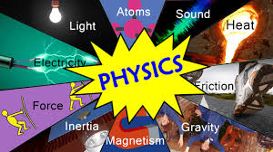
11. Bridge Course (Physics)
PHYSICS :
It is the natural science that studies matter, its motion and behavior through space and time, and the related entities of energy and force.
About Center Of Maas
The centre of mass of a distribution of mass in space is the uniqe point where the weighted
relative position of the distribution mass sums to zero.
Equation Of Motion .
Conservation of momentum.
Gravitational Force

Slide 18
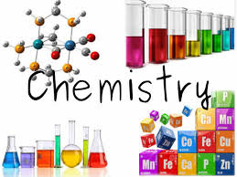
12. Bridge Course (Chemistry)
Chemistry: The scientific study of the structure of substances and what happens to them in different conditions or when mixed with each other.
Coordination Compound :- A compound containing coordinate bonds , typically between a central metal atom and a number of other atoms or groups .
Types of coordination compounds :-
Coordination Entity
Central Atoms and Central Ions
Ligands
Coordination Number
Thermodynamics :-
Its deals with the study of energy change in chemical or physical processes .
First Law of Thermodynamics
Second Law Of Thermodynamics

Slide 19

13. Interaction With TEQIP - III Coordinator
TEQIP - III provides the facilities to the college that are :-
Environment
Creative Art
Lecture by Eminent Person
Sports
Local Visit
Art Of Living
Soft Skill Training
Start-up Cell Workshop
Industry Interaction
Faculty Training at IIT Gandhinagar
Internship
The group – MECHANZIES was selected for stage 2 of Smart India Hackathon 2018- Hardware Edition.
12 ME students participated in national level technical symposium at ACCET , Karaikudi.
UCET got the best college award .

Slide 20


14. Interaction With NSS Coordinator
Introduction of NSS ?
The National Service Scheme is an Indian government sponsored flagship for public service.
Popularly known as NSS , Centenary year in 1969 .
What is NSS benefits ?
NSS is beneficial to both students as well as the society in various different means .
NSS helps the student to grow individually and also as a group . It makes the
students confident , develop leadership skills and gain knowledge about different
people .
What is the duty of NSS students ?
NSS volunteers work in rural areas , adopted villages and school to the service the
cause of society through survey , education and health awareness programmes.

Slide 21

15. Hands on Python
What is Python ?
Python is a general – purpose coding language – which means that , unlike HTML , CSS , and java script , it can be used for other types of programming and software development besides web development .
What is Python used for ?
GENERAL WEB DEVELOPMENT / BUILDING WEB APPS
DATA SCIENCE
MACHINE LEARNING
STARTUPS
THE FINANCIAL INDUSTRY
Is Python easy to learn ?
Yes, Python is easy to learn . Its syntax is easy and code is very readable . Python allow us to write programs in fewer lines of code then most of the programming language . The popularity of Python is growing rapidly .

Slide 22
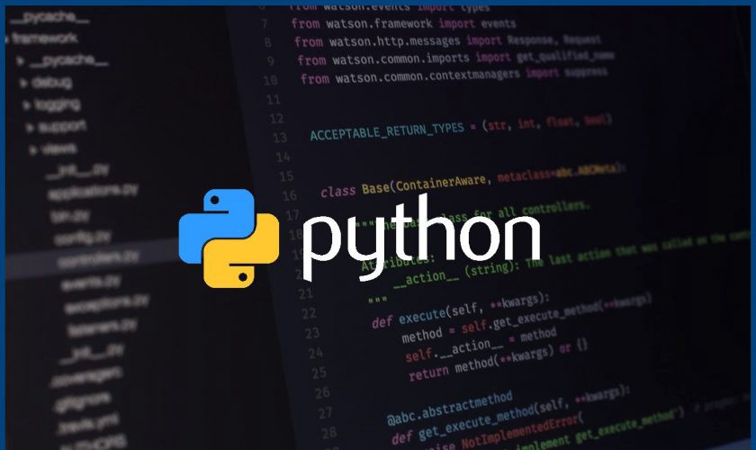
Few examples of Python programs are as below :-
1. month={‘Jan’:31 ,‘feb’:28,‘mar’:31}
print(month[‘Jan’])
31
2. var1=‘254’
if var1 :
print(“yes”)
else :
print(“you are wrong”)
yes

Slide 23
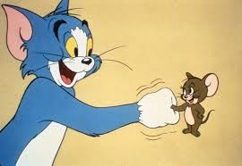
16. Workshop on Animation
What is the Normal painting & Digital painting ?
A rough drawing representing the chief features of an objects or scene and often made as a preliminary study .
Digital painting is an emerging art form in which traditional painting techniques such as watercolor , oil , impasto , etc are applied using digital tools by means of a computer , a graphics tablet and stylus and software .
Types of digital painting -
Algorithmic art
Data moshing
2D painting
3D painting
Digital photography

Slide 24
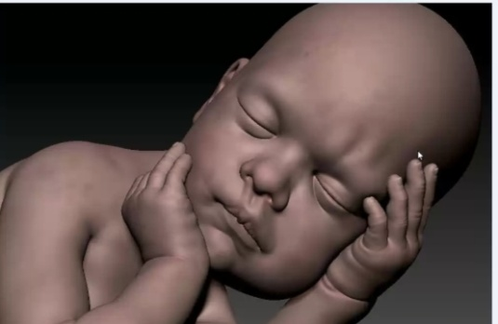
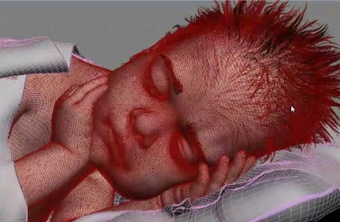
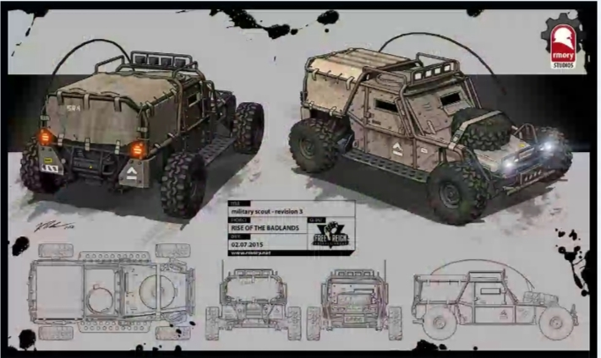

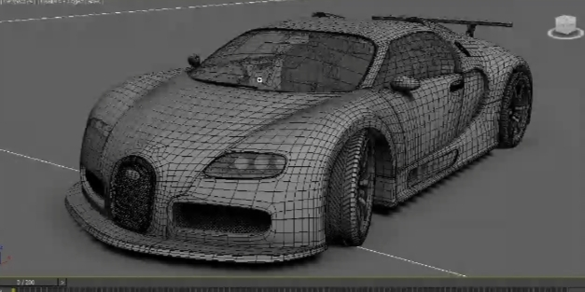
Few Examples of Animation:-

Slide 25
Role of Education
Transformation should result in changes in life-style patterns.
Attitudes & values
Knowledge
Environment friendly life styles
Practices

Slide 26
THANK YOU !

